Slide 1

Predicting Medical Insurance Charges using Linear Regression and Random Forest
By Grishma Vemireddy

Slide 2
Introduction
Problem statement:
Predict a person’s medical insurance charges based on their demographic data and lifestyle.
Purpose:
It supports risk assessment and customer profiling.
Helps understand how insurance companies estimate premiums.

Slide 3
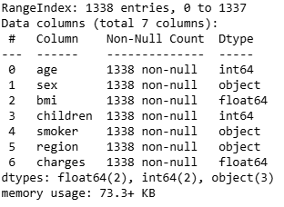
Dataset Overview
Source: Kaggle (Medical Cost Personal Datasets)
Data description:
1,338 total observation
No missing values
7 features:
age, sex, bmi, children, smoker, region, charges (target variable).

Slide 4
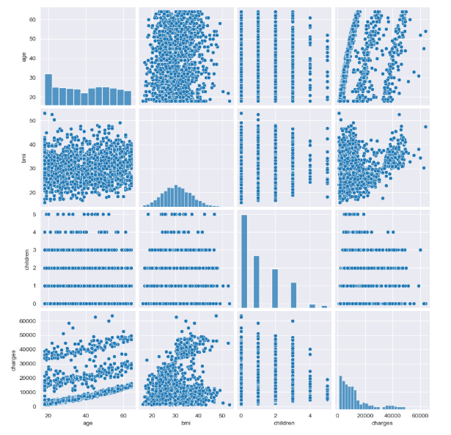
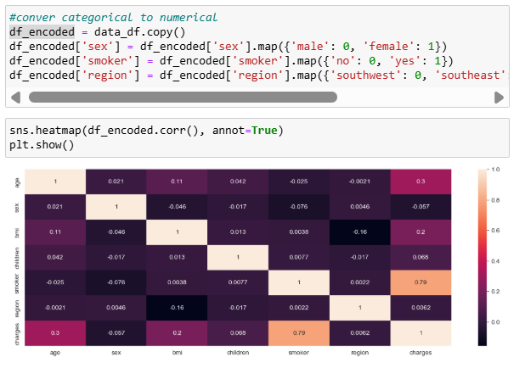
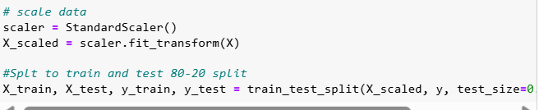
Methodology
First performed data cleaning and data exploration, scaled the data, then split data to train and test models.

Slide 5
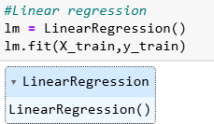
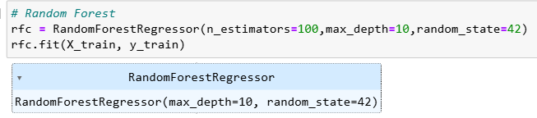
Methodology
Two regression models:
1. Linear regression
Implemented a basic model to predict charges.
2. Random Forest
I initially passed in parameters of
n_estimaors=100
max_depth=10
Then tuned and tested the model with different parameter values to see any performance improvement
n_estimaors=300
max_depth=20

Slide 6
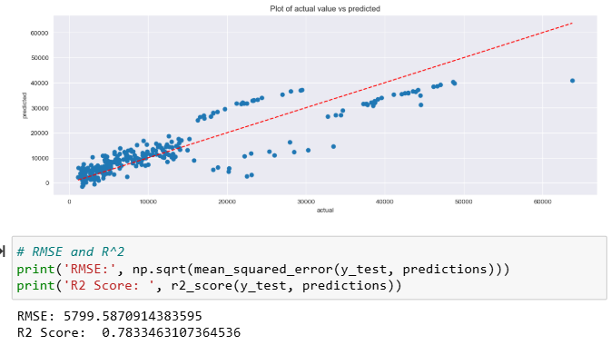
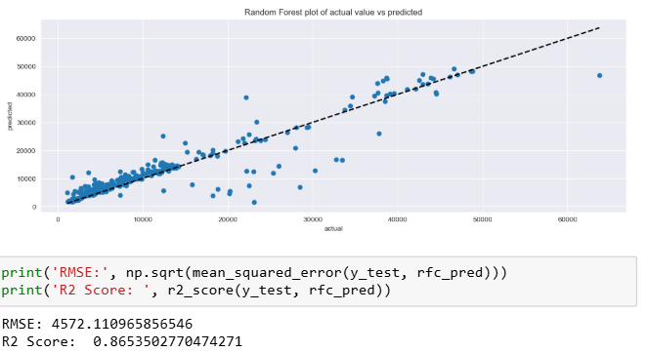
Results and Visualization
Linear Regression
Random Forest

Slide 7
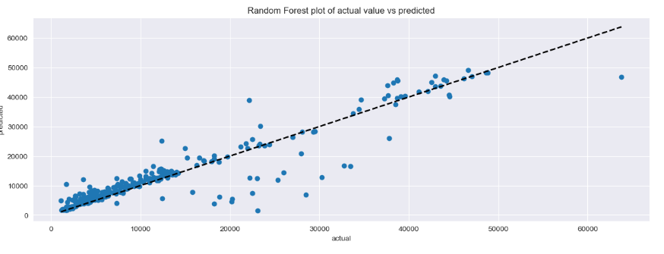
Conclusion
Overall, the random forest regression model provided with the best predictions performance with high r-squared score and lower RMSE compare with the linear regression model.
While the Linear Regression model gives a good baseline, the Random Forest model is much more effective at capturing complex relationships within the data.

Slide 8
Thank You!

